Slide 1
Curse of Dimensionality
Prof.Aruna Malapati

Slide 2
Learning Objective
Articulate the effects of curse of dimensionality

Slide 3
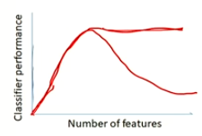
Curse of Dimensionality
As dimensionality increases the number of data points required for a classification model also increase exponentially.
Hughes Phenomenon: For a fixed number of training samples(N) in the data set the performance of the models decreases as dimensionality increase.
Reasons for this phenomenon:
Redundant Features – Carry same data in some other form
Correlation between features – the presence of one feature influence the other.
Irrelevant Features - those that are simply unnecessary

Slide 4
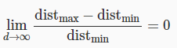
Curse of Dimensionality
The intuitions of distances in 3D are invalid in higher dimensions.
For example consider a data point x_{i} from N samples in 1D
dist_{max}(x_{i}) ≈ dist_{min}(x_{i}) that means every pair of points are approximately at the same distance from each other.
0
x_{i}
1
dist_{min}(x_{i})=min{dist(x_{i},x_{j})}
The minimum of distance between x_{i} and x_{j} such that x_{i} ≠ x_{j}
xi ≠ xj
dist_{max}(x_{i})=max{dist(x_{i},x_{j})}
The maximum of distance between x_{i} and x_{j} such that x_{i} ≠ x_{j}
xi ≠ xj
Distance measures become meaningless in higher dimensions.

Slide 5
Euclidean distance VS Cosine similarity
Euclidean distance in high dimensionality does not make the sense solution for this is using cosine similarity for high dimensional spaces.
Impact of dimensionality on cosine similarity is lower as compared to the Euclidean distance.
If the data is dense then it's impact will be high and if it is sparse then impact will be lower that means in sparse most of values are 0 so data is non uniformly spread.
Feature Subset Selection
Dimension Reduction

Slide 6
Thank You!
In our next session:Feature Subset Selection

